Slide 1
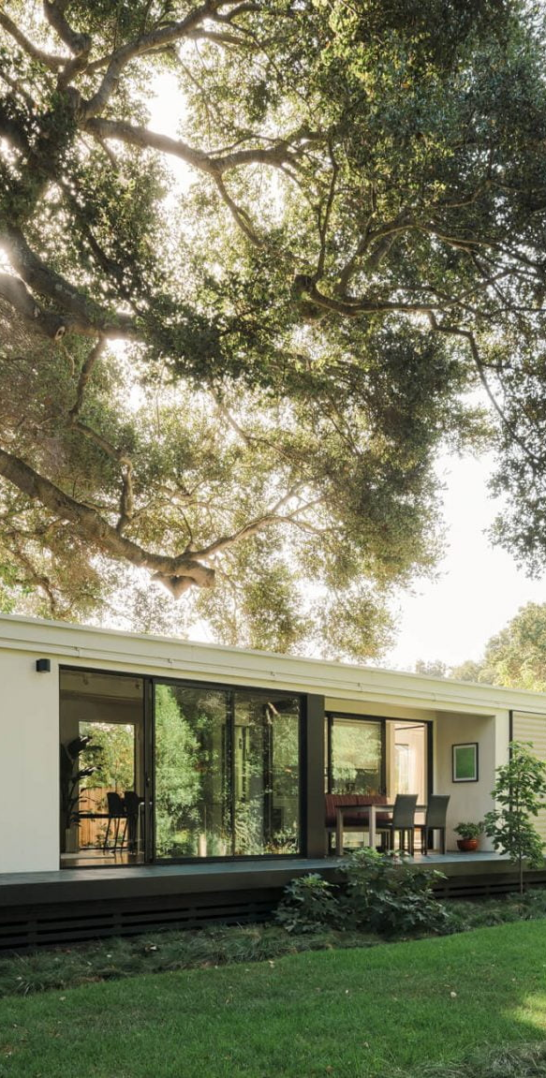

Housing Sites Inventory
Discussion Part IV
April 18, 2022
Ad Hoc Housing Committee
Town of Portola Valley

Slide 2
Meeting Format
Staff Presentation
Questions for staff and consultants
Public comments
Committee discussion
Town of Portola Valley

Slide 3
Key Topics
Building the Inventory & Work Plan
Housing Sites Discussion - Recap
Progress Updates on Committee Feedback
Accessory Dwelling Units
Town of Portola Valley

Slide 4
Goal for Meeting
Provide direction to staff on what combination of site inventory strategies should stay under consideration
Identify areas where additional analysis/investigation would be helpful- to the extent feasible
Be prepared to make Committee recommendations
on sites at the May 2nd meeting
Town of Portola Valley

Slide 5
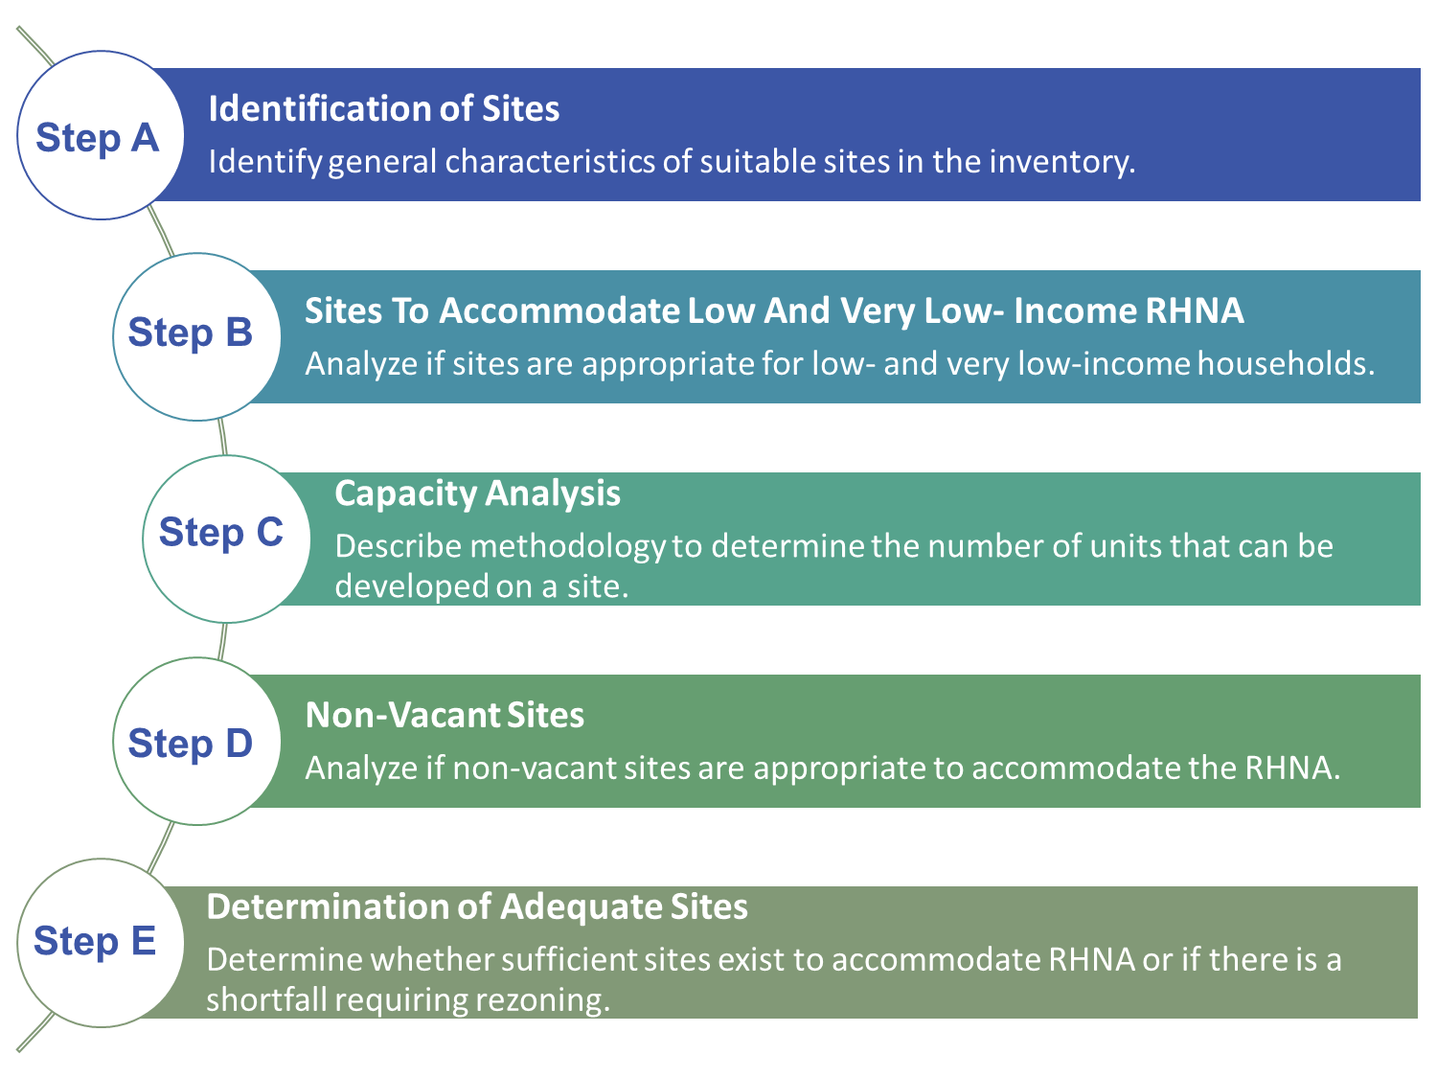
Building the Inventory

Slide 6
Work Plan
Committee recommendation
Present sites at community-wide meeting
Staff and consultants incorporate into draft Housing Element
Planning Commission and Town Council Review Draft Housing Element
*Woodside Fire Review Sites
Town of Portola Valley

Slide 7
Committee’s 10/18/21 Housing Sites Meeting
Committee began process of housing site analysis by establishing analytical framework:
  General Plan Comprehensive Plan Map, Very High Fire Severity Zone Map, Ground Movement Potential Map, Slope Map, Lot Size Map and Zoning Map
Committee expressed support for “patchwork approach”
  Various sources and types of housing Affiliated Housing Program, ADUs etc.
Town of Portola Valley

Slide 8
Committee’s 1/18/22 Fire Safety Meeting
Presentation by Town of Paradise
Fire-Adapted Communities Presentation and WFPD’s Fire Code update
Live GIS mapping presentation by Deer Creek Resources with preliminary assessment of Town’s geographical and vegetation patterns in relation to fire risk
Town of Portola Valley

Slide 9
Committee’s 2/22/22 Housing Sites Meeting
WFPD Presentation on Comprehensive Hazard and Risk Assessment
Housing Sites Inventory Presentation including updated land use constraints maps
Draft projection of the Regional Housing Needs Allocation (RHNA) by income category
Potential housing sites
Town of Portola Valley

Slide 10
Committee’s 2/28/22 Housing Sites Meeting
Very well attended – over 160 attendees!
Lively, productive discussion
Lead to new ideas from the Committee (8 new ideas)
PIVOT - Staff reviewed the work plan, budget and schedule
Postposed Community Wide Meeting (now May 9th)
Council meeting on March 23rd to discuss priorities and resources
Town of Portola Valley

Slide 11
2/28/22 Committee Mtg Feedback Updates
Feedback Item | Progress Update
Explore new housing sites including further analysis of Glen Oaks Stanford parcel, El Mirador parcel behind Town Hall and Neely property on Portola Road | Maps with rough estimates for amount of developable land available after mapping creek and scenic corridor setbacks and/or hazards constraints: • Glen Oaks Stanford - 4.4 acres • El Mirador – 13.2 acres • Neely property – 25 acres

Slide 12
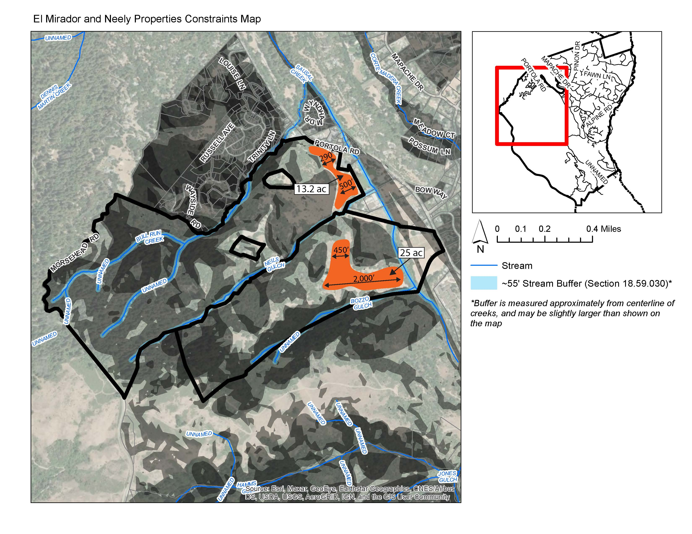
Recap of 2/28 Committee Meeting
Town of Portola Valley

Slide 13
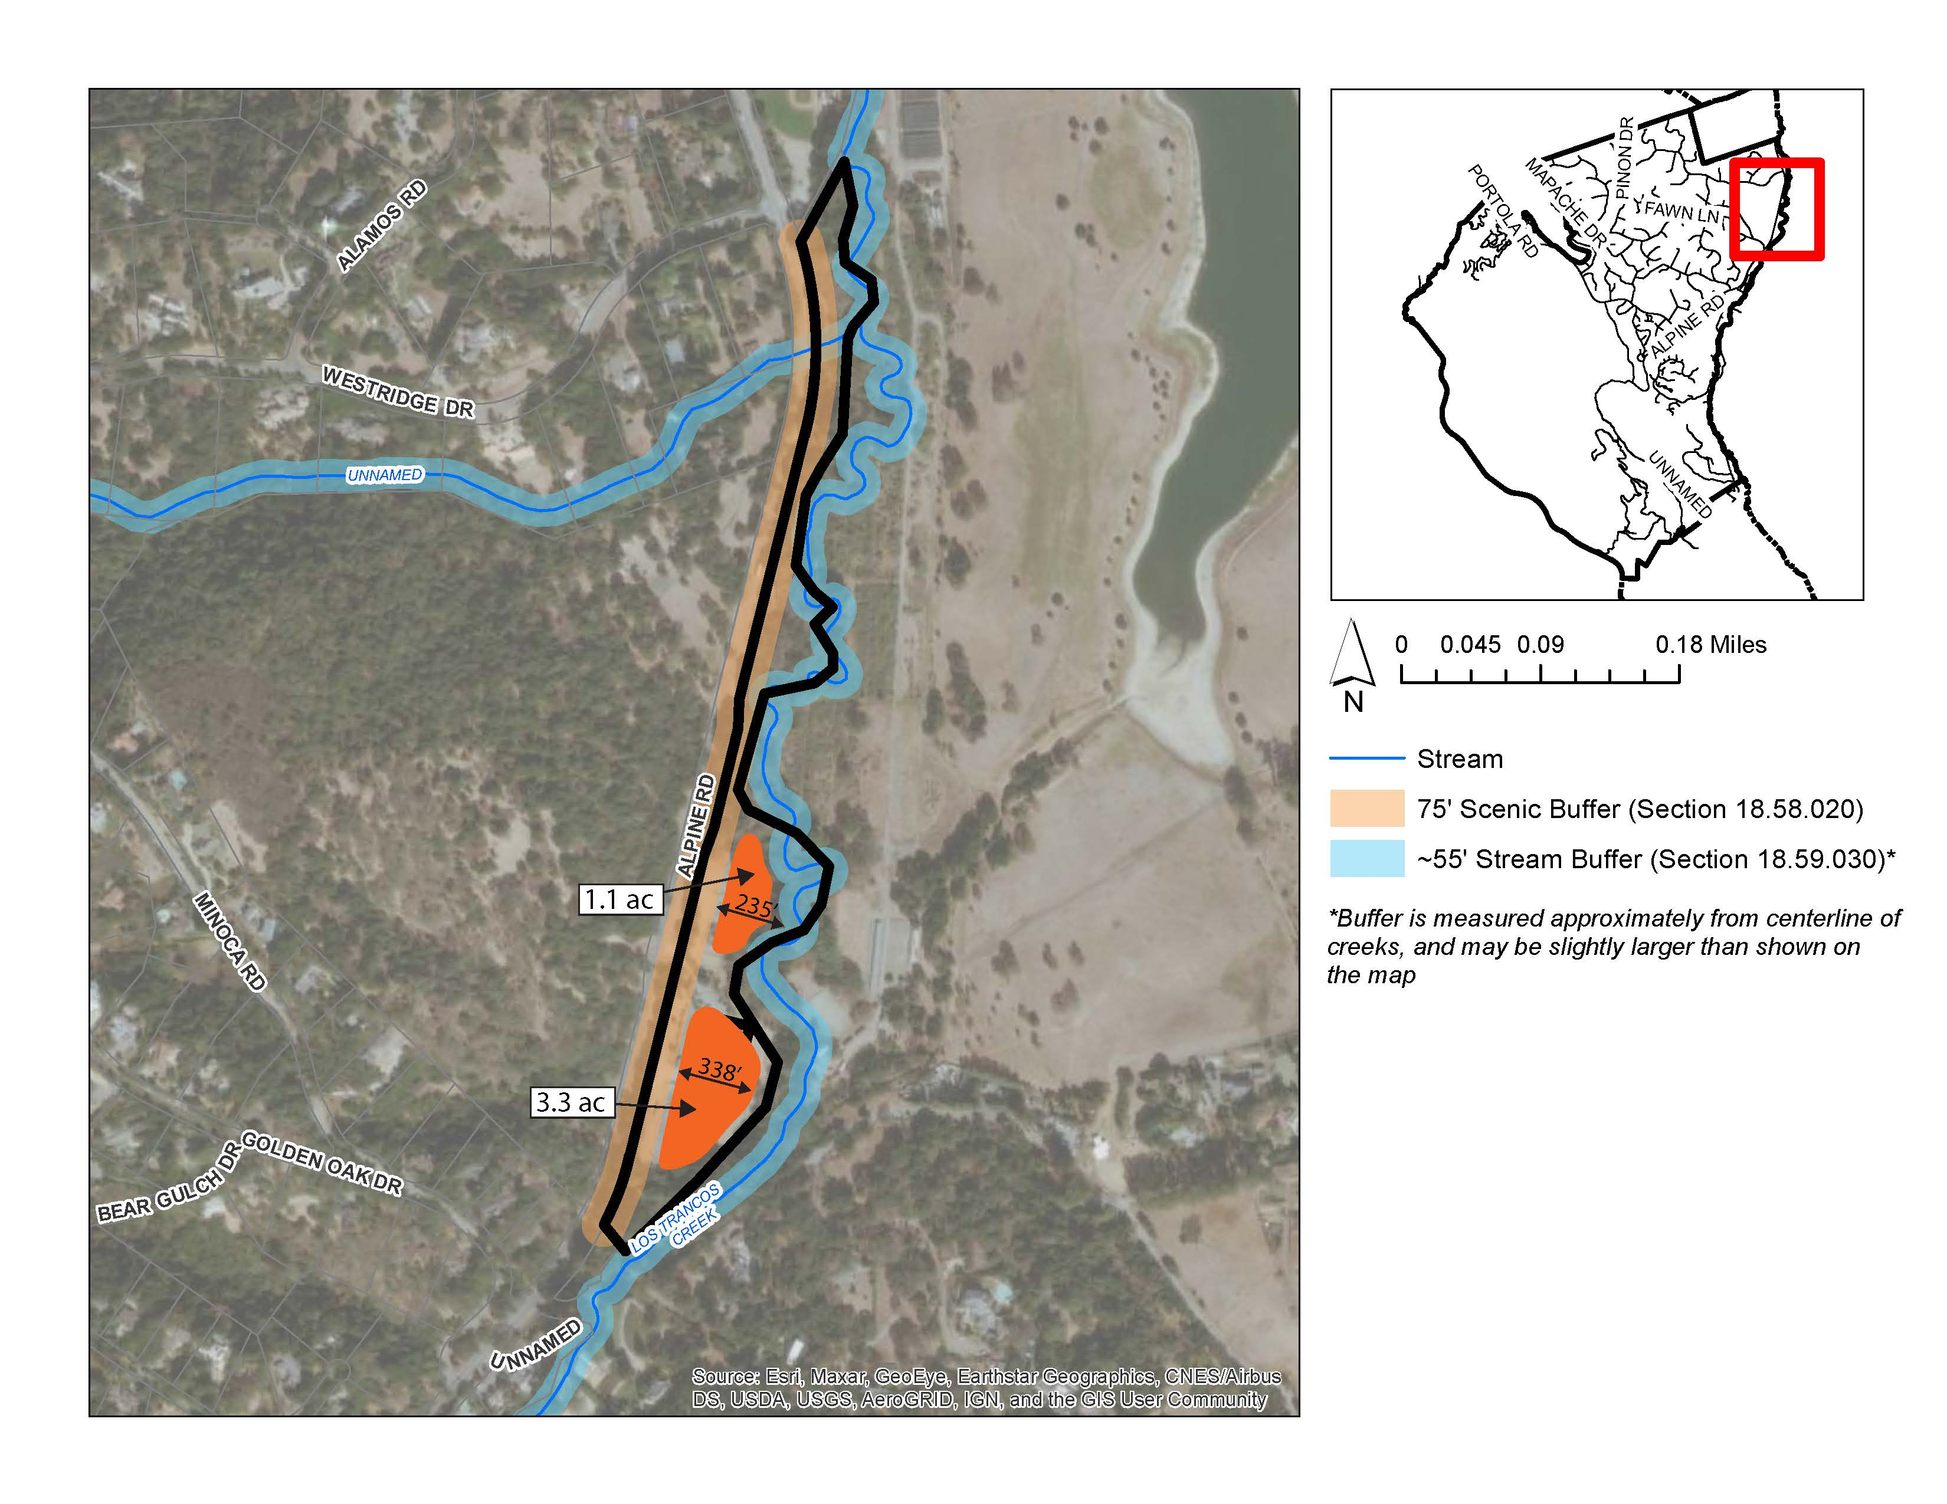
Recap of 2/28 Committee Meeting
Glen Oaks – Stanford Constraints Map
Town of Portola Valley

Slide 14
2/28/22 Committee Mtg Feedback Updates
Feedback Item | Progress Update
Further study potential for mixed use in the Town’s C-C and A-P zones while preserving local-serving businesses | Development potential is expected to be limited. Analysis is underway and will be presented at the May 2, 2022 meeting.
Further study development potential of the two vacant parcels on Alpine Road as sources of multi-family housing | Staff/consultants are analyzing development potential of 3 parcels: parking lot behind Robert’s, vacant parcel next to Robert’s, and 4370 Alpine at corner of Alpine and Nathorst. Staff will report back at the May 2, 2022 meeting.

Slide 15
2/28/22 Committee Mtg Feedback Updates
Feedback Item | Progress Update
Explore an “opt-in” approach where property owners could volunteer for upzoning | Mailers sent to Portola Valley property owners with parcels 1 acre or larger to identify volunteers interested in upzoning their property. Property Upzone discussion is scheduled for interested property owners for April 21, 2022 at 4pm.
Investigate dispersing housing sites throughout community via overlay zone allowing up to 6 dwelling units/acre (assumes units would be market rate w/ potential for small number of affordable units) | Mailer included the option for interested property owners to upzone their property to up to 6 dwelling units/acre.
Revisit list of Town-owned property to see if there is development potential | Composite Map of Town-owned properties overlayed with hazards constraints. Ford Field identified as a feasible site with at least 1.1 acre of developable land. Development potential analysis underway and will be presented at the May 2, 2022 meeting.
Town of Portola Valley

Slide 16
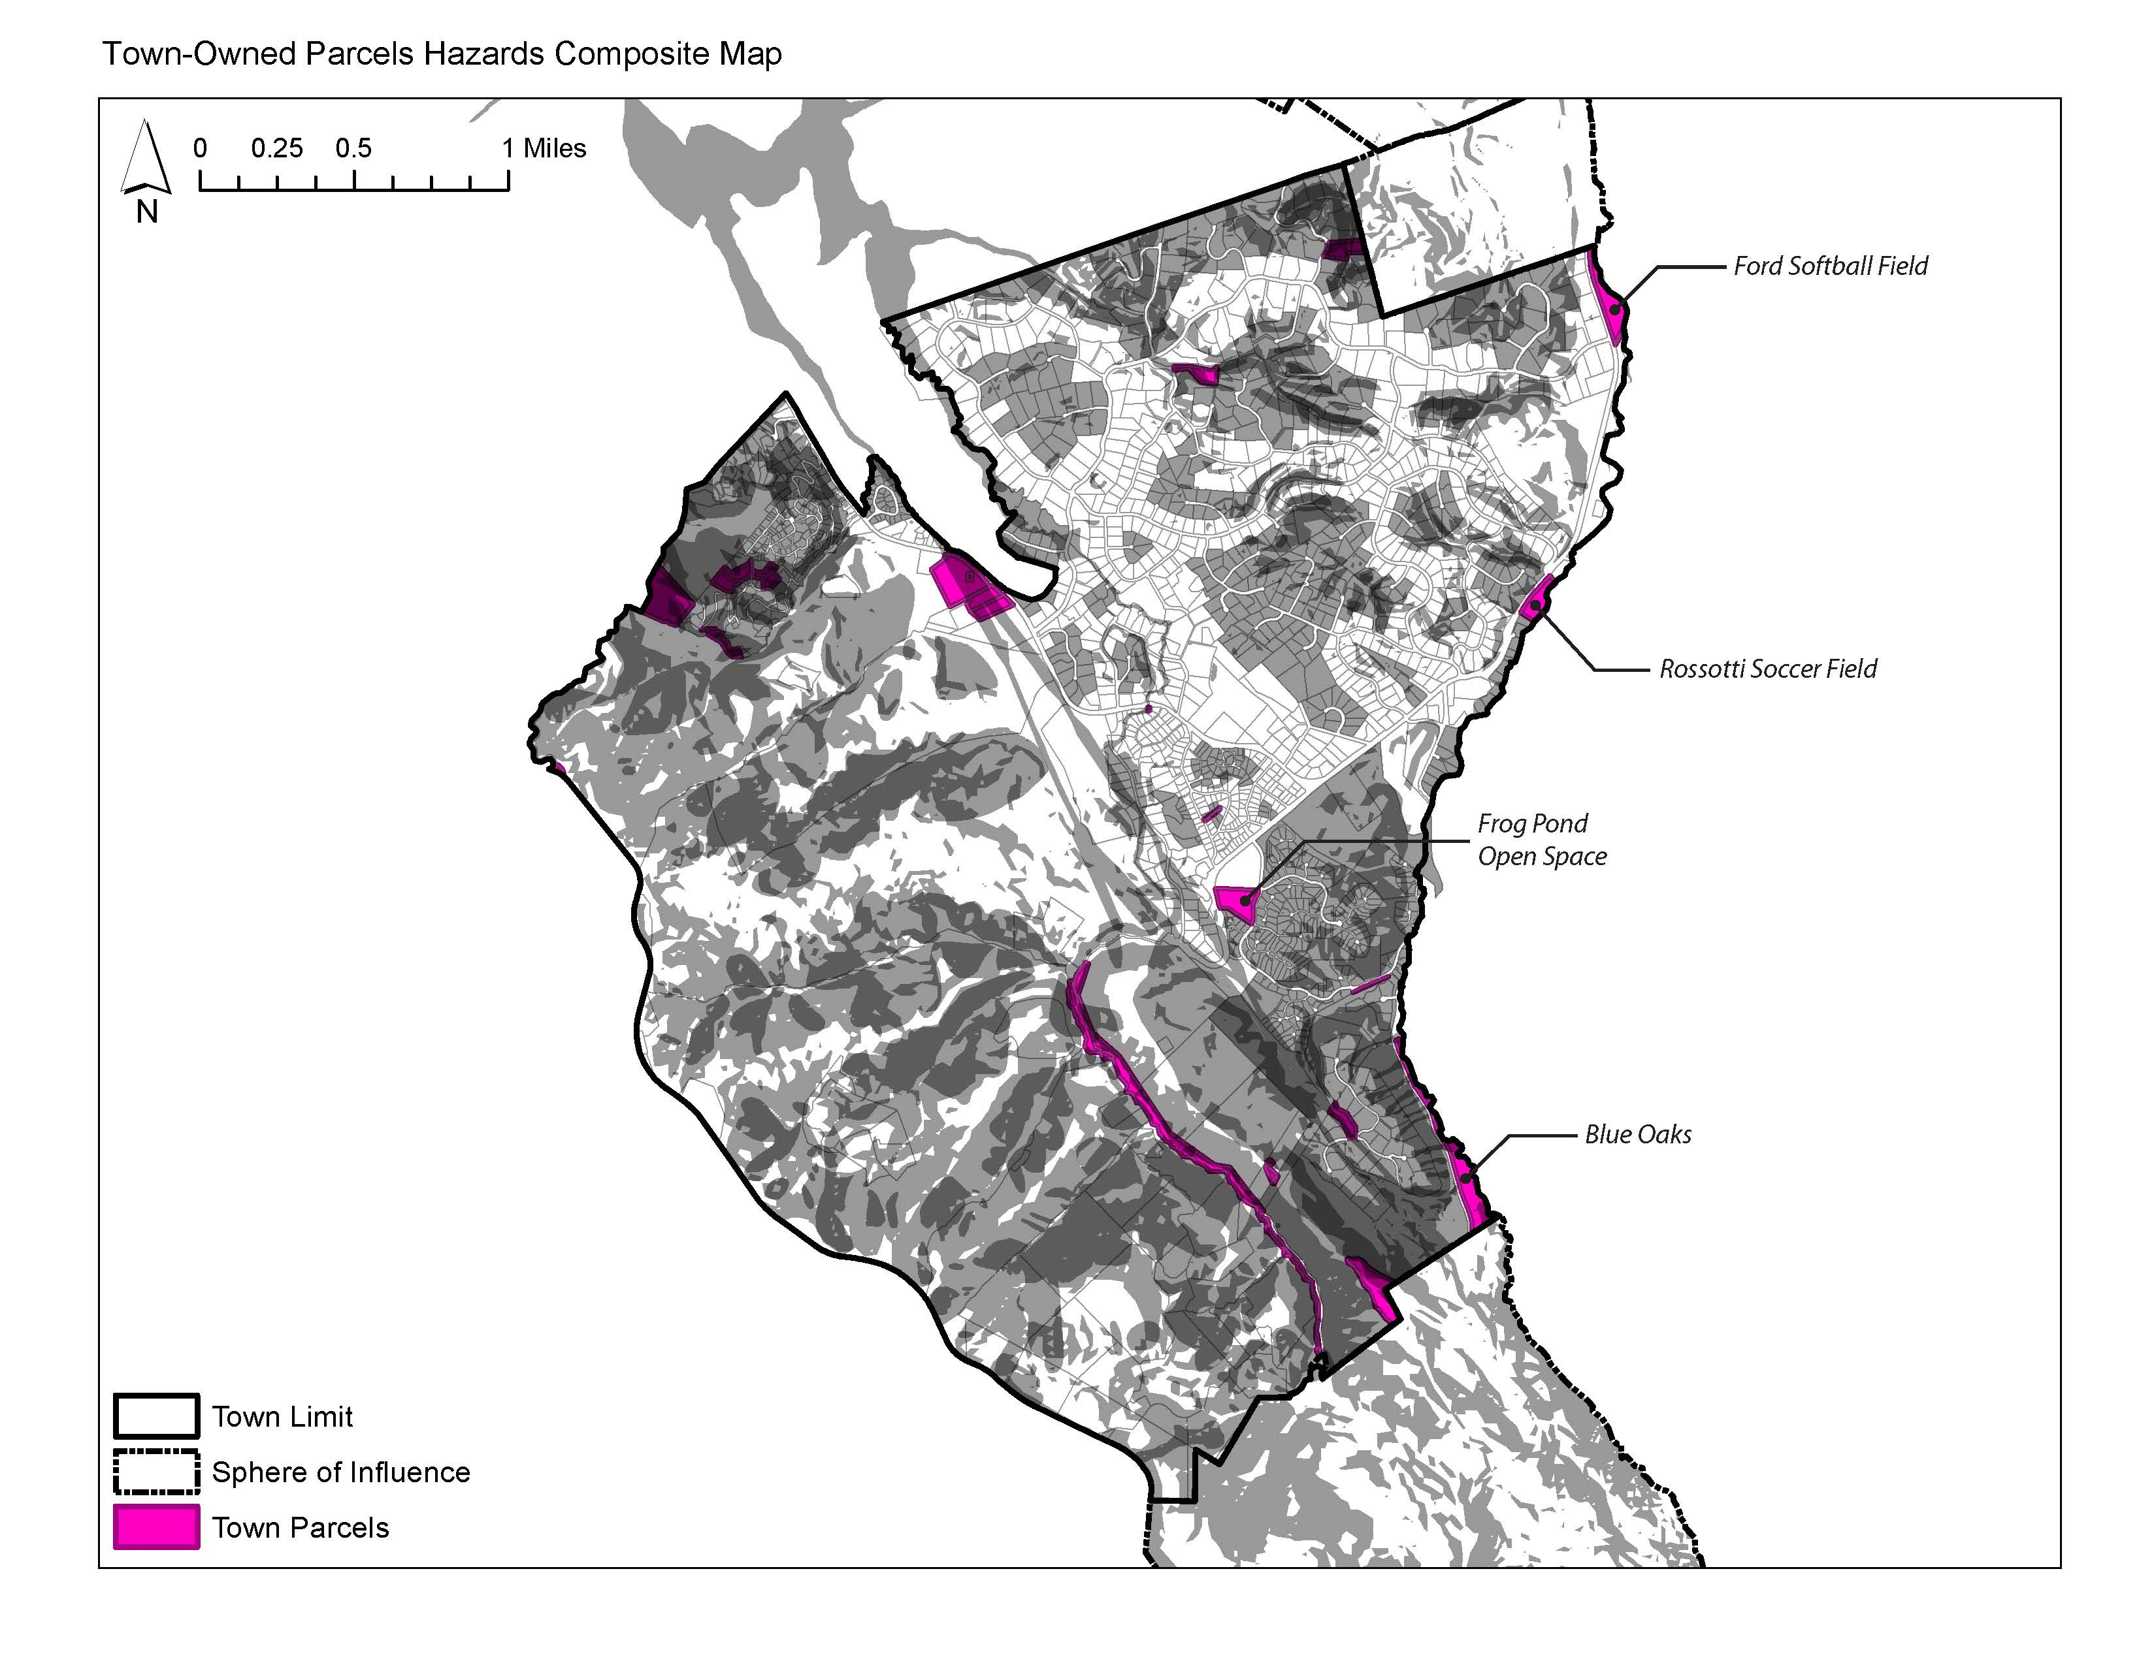
Recap of 2/28 Committee Meeting
Town of Portola Valley

Slide 17
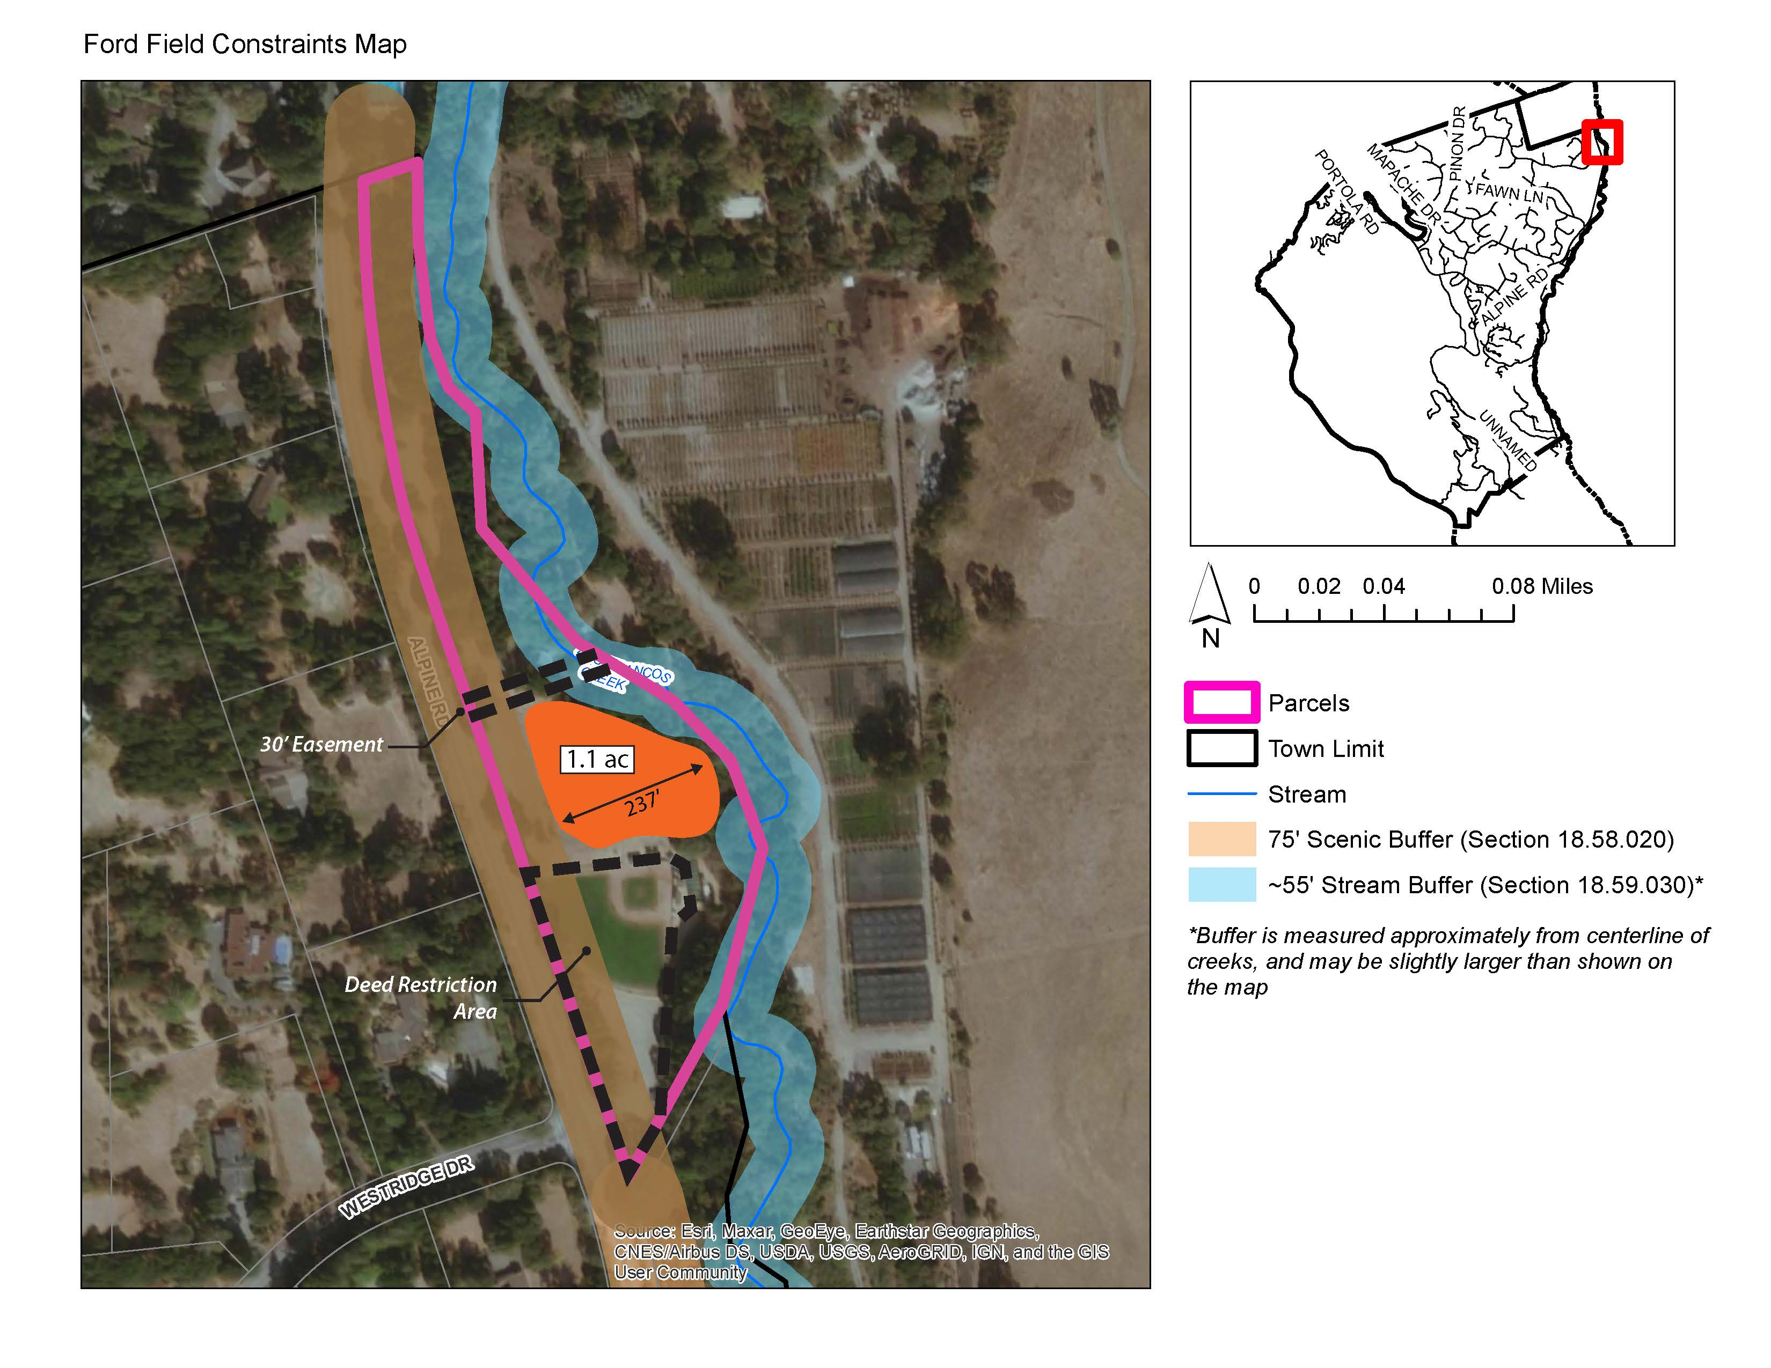
Recap of 2/28 Committee Meeting
Town of Portola Valley

Slide 18
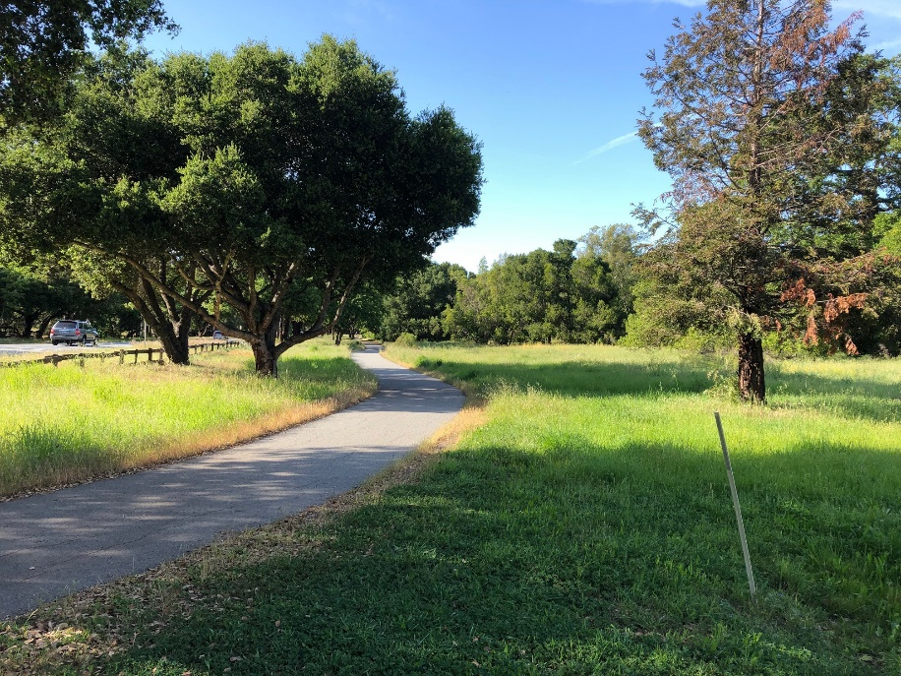
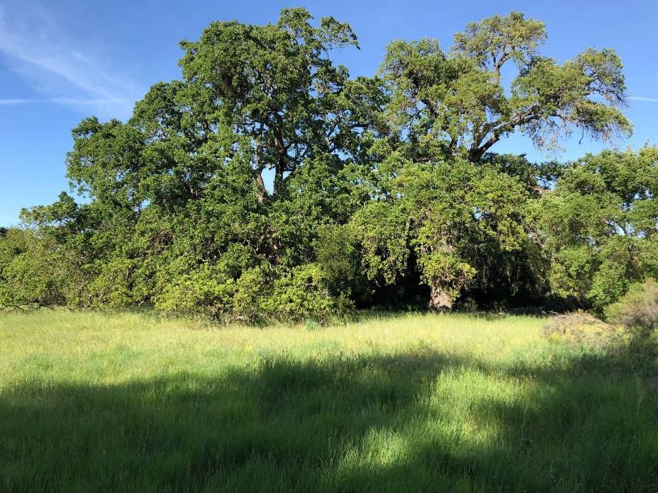
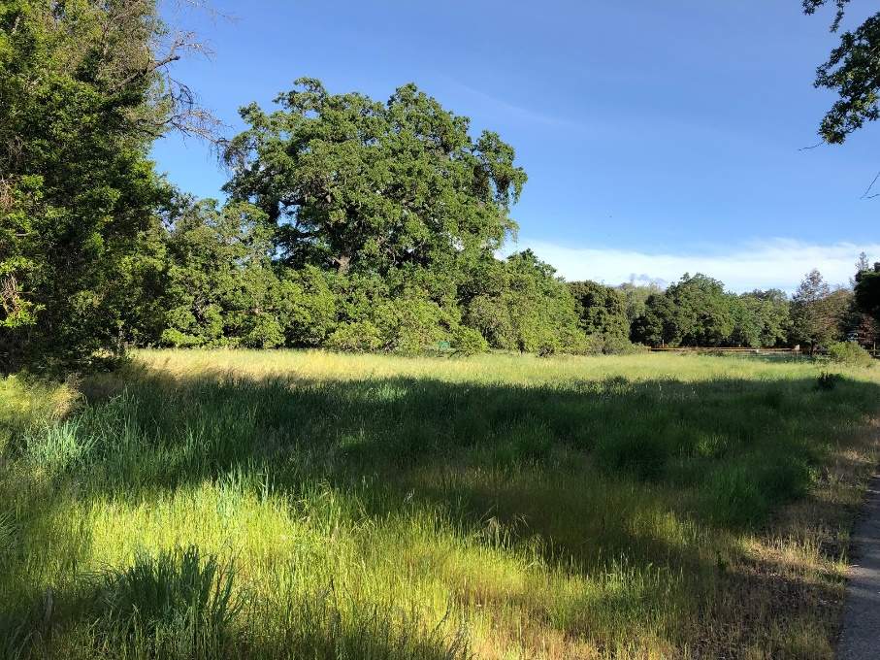
2/28/22 Committee Mtg Feedback Updates
Ford Field
Town of Portola Valley

Slide 19
2/28/22 Committee Mtg Feedback Updates
Blue Oaks
  13 acres total
  Four parcels dedicated for “Open Space” and “Open Space Neighborhood Preserve” to satisfy Town’s requirements for park/recreation area with the subdivision
  Additional research and feasibility analysis required
Town of Portola Valley

Slide 20
2/28/22 Committee Mtg Feedback Updates
Feedback Item | Progress Update
Consider using Town’s affordable housing fund to provide incentives for affordable housing (such as multifamily or ADUs) | No additional materials have been prepared. The Committee may wish to continue discussing how funds may support different options.
Revisit ADU process to see if additional streamlining is possible | ADU Focus Group scheduled for April 19, 2022 at 4pm to explore applicant experiences and additional streamlining options.
Town of Portola Valley

Slide 21
Accessory Dwelling Units
At Nov. 15, 2021 meeting, concerns expressed about whether ADUs really supply affordable housing
Discussed two allocation formulas – have been using more conservative numbers, with ADUs concentrated in higher income categories
After renewed interest at recent Committee meetings, staff updated unit total table to include standard ADU allocation - similar to other cities/towns in the County
Satisfies more of the lower income units
Town of Portola Valley

Slide 22
Regional Housing Needs Allocation (RHNA) – Draft Projection
Town of Portola Valley

Slide 23
Total Housing Sites Outstanding
Very Low Income: 59 units
Low Income: 2 units
61 units
(min. 20 DU/Acre)
Mod Income: 5 units
Above Mod Income: 84 units
89 units
Town of Portola Valley

Slide 24
Housing Sites Options
Very Low Units | Low Units | Moderate Units | Above Mod Units | Total Units
59 | 2 | 5 | 84 | 150
61 |  | 89
= ~3.1 Acres @ 20 DU/Acre or 2 acres @ 30 DU/Acre |  | = 4.5 Acres @ 20 DU/Acre or 6 Acres @ 15 DU/Acre or 15 Acres @ 6 DU/Acre |  | 7.5 acres – all @ 20 DU/Acre
Town of Portola Valley
Notes:
- Based on current estimates, these are all of the units we need to plan for:

Slide 25
Committee Discussion
Should ADUs be emphasized in the affordable housing strategy? Should the Town use the ADU allocation presented?
Up to this point, the Town has not analyzed sites that would replace active recreational or open space uses- not considered a best practice. Should the staff/consultant team analyze those sites?
What combination of sites inventory strategies should stay under consideration, and which should be removed from consideration?
Town of Portola Valley

Slide 26
Discussion- Site Strategies
Additional Analysis Already Underway:
  Town Center Substation next to soccer field (less than 1 acre)
  Ford Field (at least 1.1 acres)
  Parking lot behind Robert’s (1.1 acres)
  Empty lot next to Robert’s (1.2 acres)
  Corner of Alpine and Nathorst - 4370 Alpine (2.5 acres)
Town of Portola Valley

Slide 27
Discussion- Site Strategies
Single Family Upzoning
  Only consider properties that opt in? Would result in multifamily housing spread around the community
  Consider upzoning but NOT make single family legal nonconforming? This would allow single family uses to continue into the future
  Properties generally in Nathorst area?
  Properties on Alpine Road near Ladera?
Town of Portola Valley

Slide 28
Discussion- Site Strategies
Commercial Properties
  Write policy to emphasize retention of existing businesses and fit in housing units where possible? OR
  Write policy to allow demolition of existing buildings but require new commercial to be built? This would result in new mixed use development
Town of Portola Valley

Slide 29
Discussion- Site Strategies
Glen Oaks - Stanford
  Start official process by staff reaching out to Stanford?
Neely
  Preservation of site has been priority of Planning Commission in recent years. Continue communications with owner to evaluate potential timeframe for planning process?
Blue Oaks
  Continue research and site feasibility?
Town of Portola Valley

Slide 30
Upcoming Meetings
Monday, May 2 – Ad Hoc Housing Element Committee meeting to finalize the draft sites inventory
Monday, May 9 – Community Wide Meeting at 7 pm via zoom to hear an update on the Committee’s work and provide feedback
Tuesday, May 24 – Ad Hoc Housing Element Committee meeting to review the draft Housing Element
Town of Portola Valley

